Slide 1

RESTful - Web Services and APIs Development
Trainer igor.mitkovski@gmail.com
Assistant dejan.pblazheski@seavus.com

Slide 2
History
ASP.NET WEB API
Roy Fielding defined REST in his 2000 PhD dissertation "Architectural Styles and the Design of Network-based Software Architectures"
Roy developed the REST architectural style in parallel with HTTP 1.1 of 1996–1999, based on the existing design of HTTP 1.0 of 1996.
Code academy @ Skopje, 2018-2019

Slide 3
Representational State Transfer (REST)
ASP.NET WEB API
Software architectural style that defines a set of constraints to be used for creating Web services.
Web services that conform to the REST architectural style, called RESTful Web services (RWS), provide interoperability between computer systems on the Internet.
Code academy @ Skopje, 2018-2019

Slide 4
RESTful systems
ASP.NET WEB API
Aim for fast performance, reliability, and the ability to grow by reusing components that can be managed and updated without affecting the system as a whole, even while it is running.
Resource identification through URI
Uniform interface
Self-descriptive messages
Stateful interactions through hyperlinks
Code academy @ Skopje, 2018-2019

Slide 5
Fundamental REST Principles
ASP.NET WEB API
Client-Server Communication
Stateless
Cacheable
Uniform Interface
Code academy @ Skopje, 2018-2019

Slide 6
Simple Object Access Protocol (SOAP)
ASP.NET WEB API
Messaging protocol specification for exchanging structured information in the implementation of web services in computer networks
Its purpose is to provide extensibility, neutrality and independence
Allows processes running on disparate operating systems (such as Windows and Linux) to communicate using Extensible Markup Language (XML)
Code academy @ Skopje, 2018-2019

Slide 7
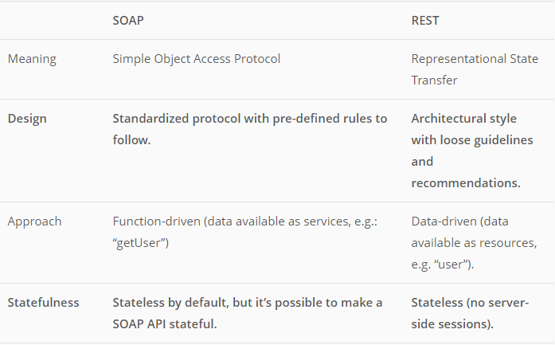
REST vs SOAP
ASP.NET WEB API
Code academy @ Skopje, 2018-2019

Slide 8
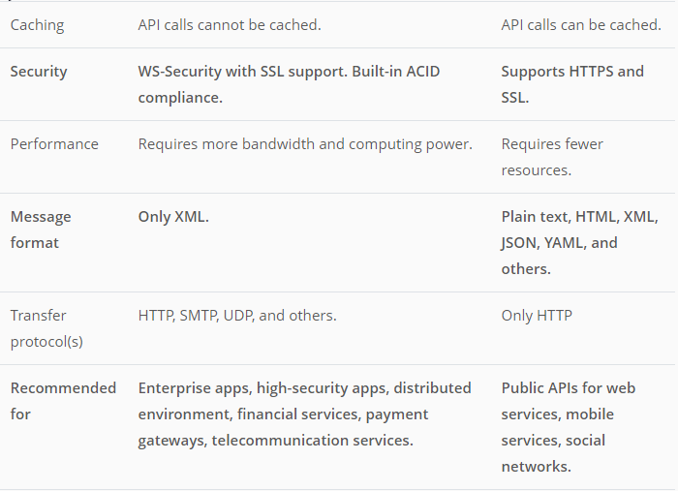
ASP.NET WEB API
Code academy @ Skopje, 2018-2019

Slide 9
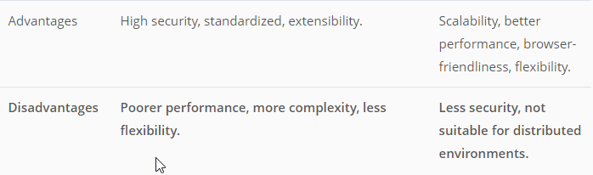
ASP.NET WEB API
Code academy @ Skopje, 2018-2019

Slide 10
Let's create our first web api project
ASP.NET WEB API
Code academy @ Skopje, 2018-2019

Slide 11
?
ASP.NET WEB API
Code academy @ Skopje, 2018-2019

